Slide 1
Project 1

Slide 2
Project Description: Website Sign-Up
In this project, you will write a program that prompts a user to sign up for a website. The user must come up with a username and password, then log in using the username and password.
There are requirements for both the username and password. If either one doesn’t meet the requirements, print an appropriate error message and ask the username for a new username and password.
If they are both valid, store them as variables. Then ask the user to log in using the username and password they chose.

Slide 3
Username Requirements
Inform the user of these requirements. The username must:
Follow all the Python conventions for a variable name. It must start with a lowercase letter and only contain letters, numbers, and underscores.
Not be in a list of taken usernames. This list will be given to you.
Taken usernames = ‘admin’, ‘admin123’, ‘superuser’, ‘superuser123’
If the username doesn’t meet these requirements, print either “Invalid username” or “Username taken” based on the context, and continue looping.

Slide 4
Password Requirements
Inform the user of these requirements. The password must be:
At least 8 characters long
Contains at least one uppercase letter
Contains at least one lowercase letter
Contains at least one digit
Contains at least one of these characters: !, ?, @, #, $, ^, &, *, _, -
Doesn’t contain any spaces
If the password doesn’t meet the requirements, print the message “Invalid password” and continue looping.

Slide 5
Logging In
Once the user has created a valid username and password, print “Sign up successful”.
Now, prompt them to log in. Ask them to enter their username and password.
If either one doesn’t match, print “Incorrect username or password” and continue looping.
Otherwise, print “Login successful” and end the program.

Slide 6
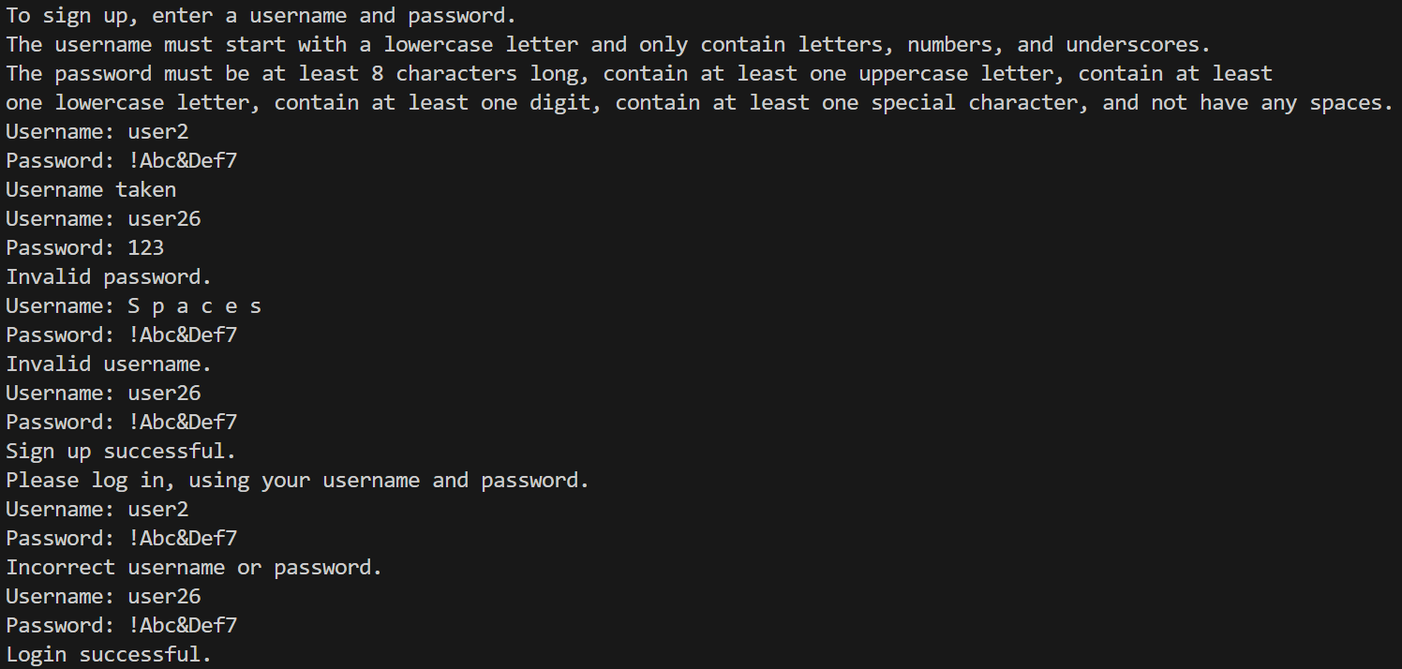
Sample Program Run

Slide 7
Work Time

